Slide 1
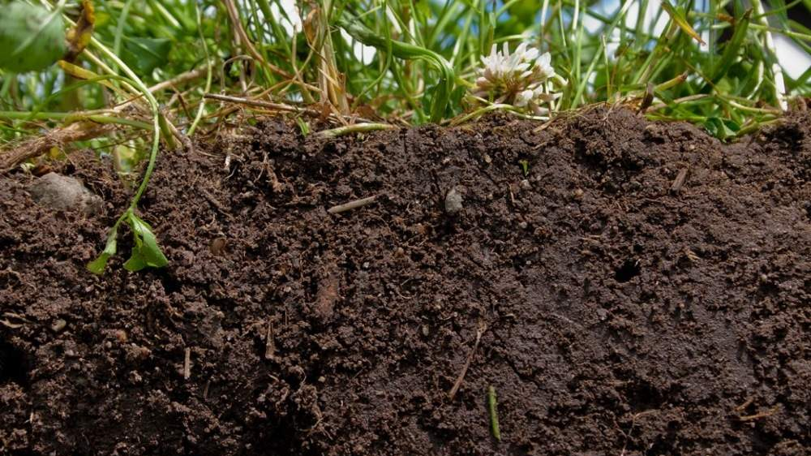
Soil Aggregate Stability Analysis Research Proposal
Rocio Hernandez
Notes:
Hello everyone! I’m Rocio Hernandez & my research proposal is connected to my thesis research: determining soil aggregate stability in connection to land management use.

Slide 2
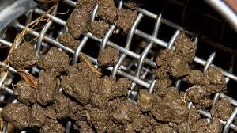
Introduction/Background
What is a soil aggregate?
Soil aggregates indicators of health
Agriculture & Soil Degradation
Land Management assessment
Notes:
Soil aggregates, a biological component of the soil. Their main function is to stick together by utilizing microbial colonies, and plant/microbial exudates( substance secreted by plants or animals). As soil aggregates bind together they in turn help retain structure, make way for gas exchange, transport of liquids, and also serve as resistance against environmental/climate/weather and anthropogenic activity.
These aggregates are considered to be indicators of health, and therefore are critical to understanding.
So what is the problem?
Aggregates naturally break down with time, however they are heavily and at a more rapid speed affected by agricultural land management- so I will attempt to understand this by assessing a small sample of soils that have been managed under three different soil cultivation strategies to try and communicate through data visualization which land management strategy can help retain stronger soil aggregation.

Slide 3
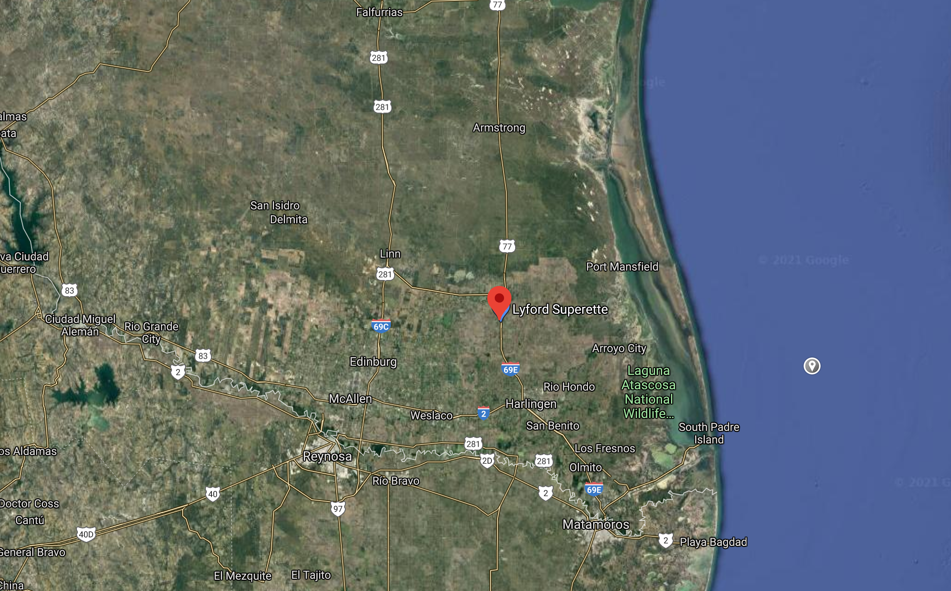
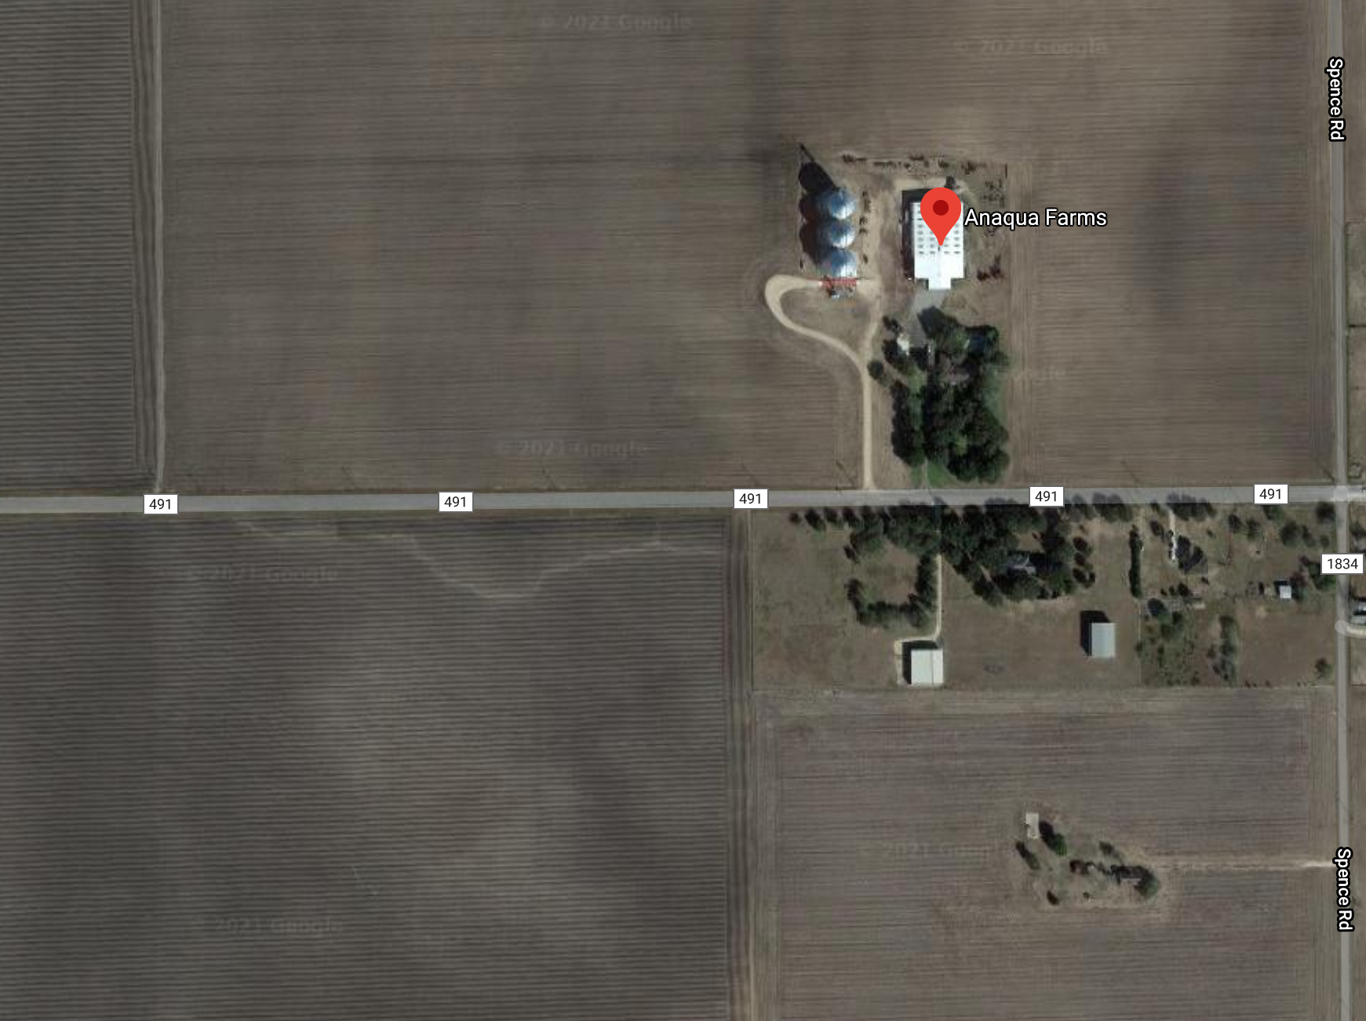
Research Design
Location: Anaqua Farms
Small results sample.
Tillage Practices: Conventional, intermittent and strip tillage.
Notes:
For this assignment I have taken data from a much larger research project that I am currently working on.
Location: Anaqua farms located in Lyford, TX.
The samples have come from three distinct fields, all under different tillage strategies.
Conservation/strip tillage: least amount of disturbance on portion of the bed w/minimal frequency throughout a growing season..
Intermittent tillage: Done more often than strip tillage, periodically during growing seasons.
Conventional tillage: Most amount of soil disturbance, used frequently to prevent weed, refine the soil and/or plant.

Slide 4
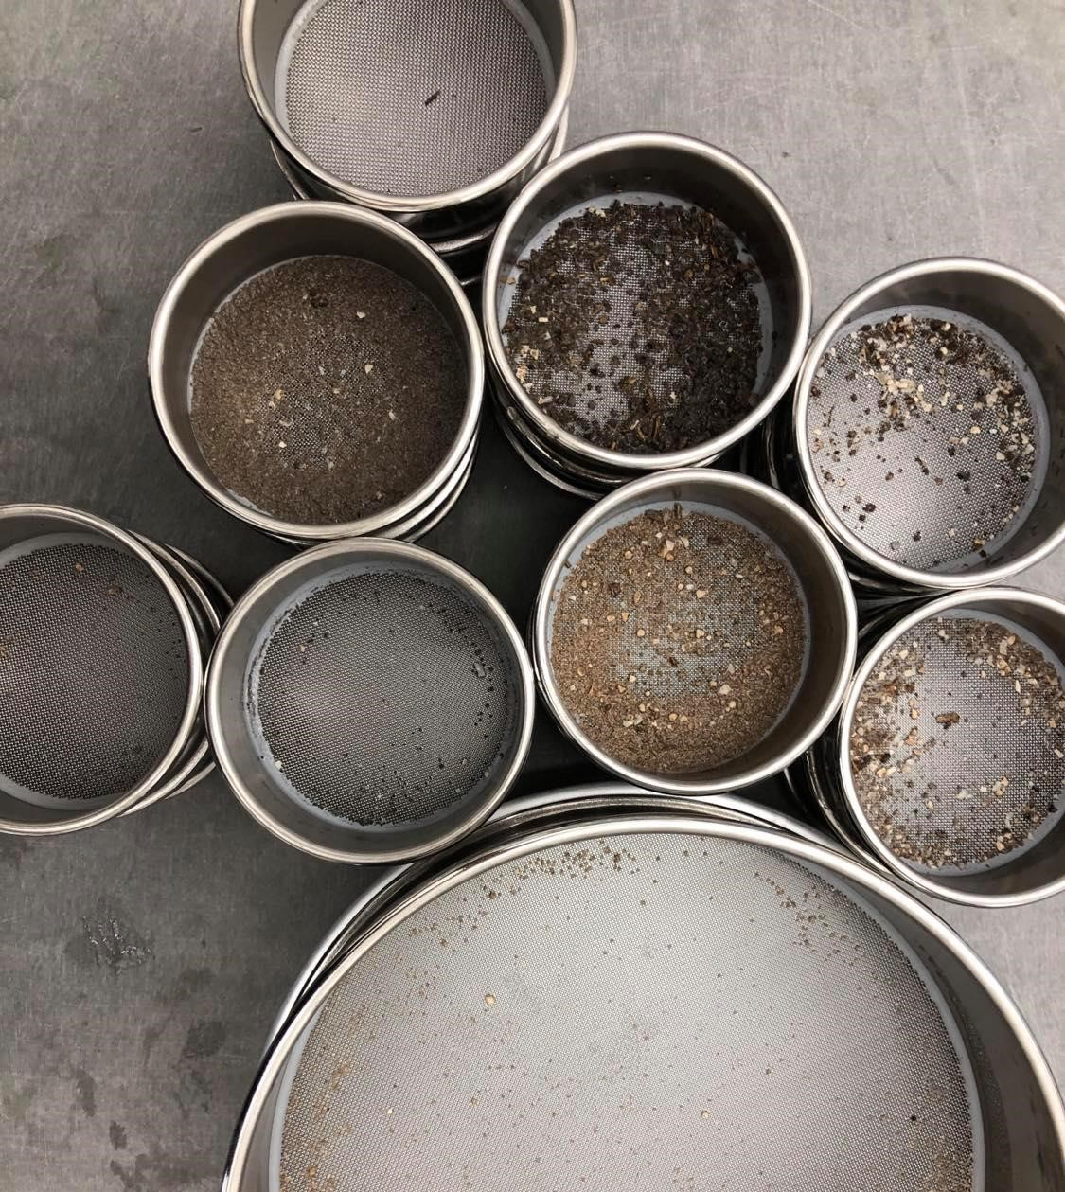
Research Hypothesis
Q: Will tillage type affect the stability of soil aggregates within the soil.
Q: Will texture quantities correlate w/ aggregate stability %.
Hypothesis: Soils that have been strip (conservation) tilled have a higher percentage of aggregate stability than soils that have been conventionally or intermittently tilled.

Slide 5
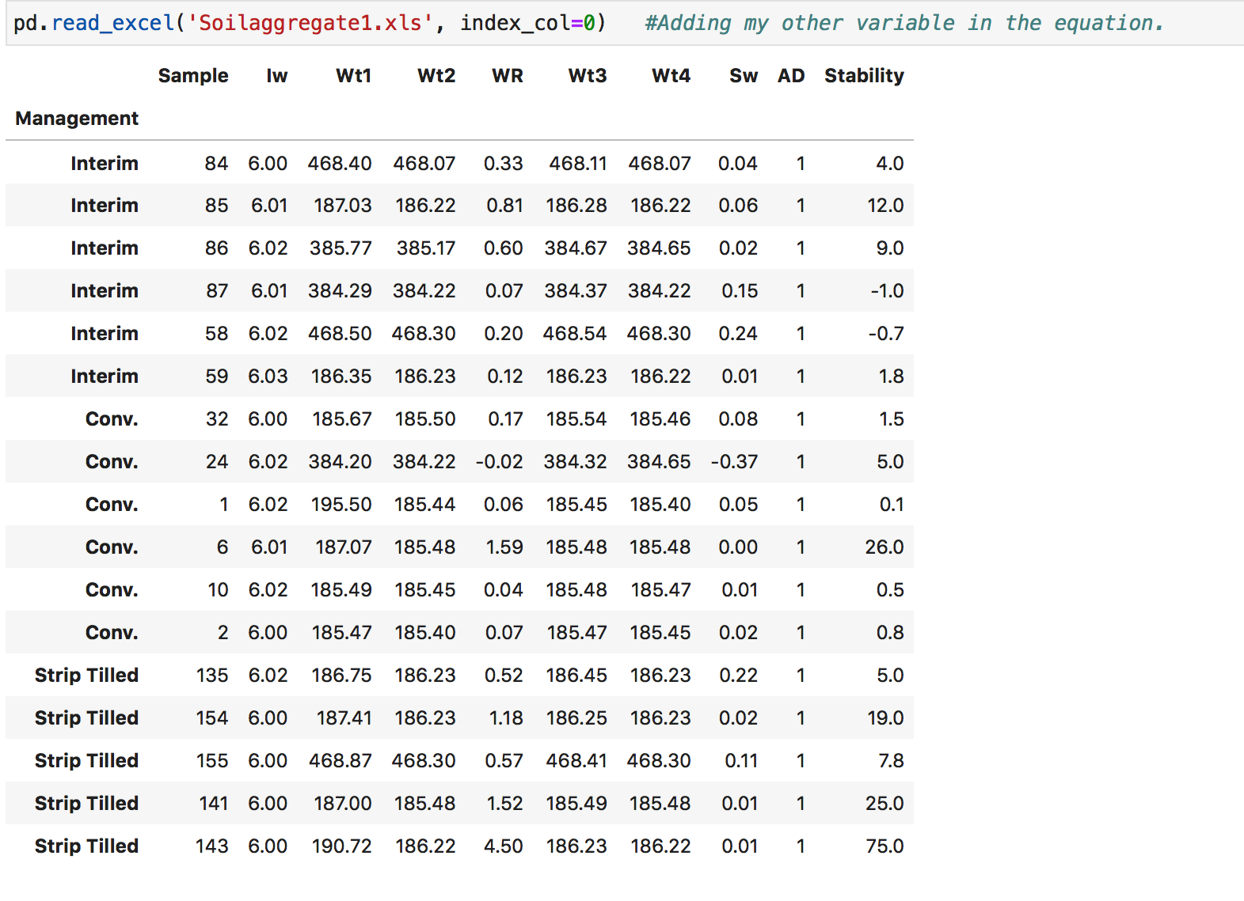

Python Analysis
Uploading Data -> Csv File
Utilizing Pandas for basic statistics analysis
Scatter Plot Comparing Variables
Creating a Function w/ the following equation to determine aggregation % of samples:
Stability %=(WR-SW)/ (IW/(AD/OD)-Sw) X100
Iw: Initial sample weight.
WR: Total weight of aggregates lost in the process.
Sw: Weight of sand.
AD: standard 1.0 (air-dry/oven-dry weight)
Notes:
Independent variable: tillage practices (x)
Dependent variable: soil aggregate stability
Here is the very small data sample I was working with, mostly in part because this was the only data I had available when this assignment wastasked. At this point, I now have almost 150 samples that I can plot, which I think I can now say I’m looking forward to.
So I digress, uploaded the CSV.
Was able to create a function that outlines the different variables involved in determining how to tell if a soil is stable or not.
So essentially, we take a sample in the lab
Run it through a series of environmental stressors, as the weather would naturally on any given soil.
Through this, we record Iw, WR, the weight of one of the largest soil components(sand) and can then determine the stability percentage through this wet aggregate lab.

Slide 6
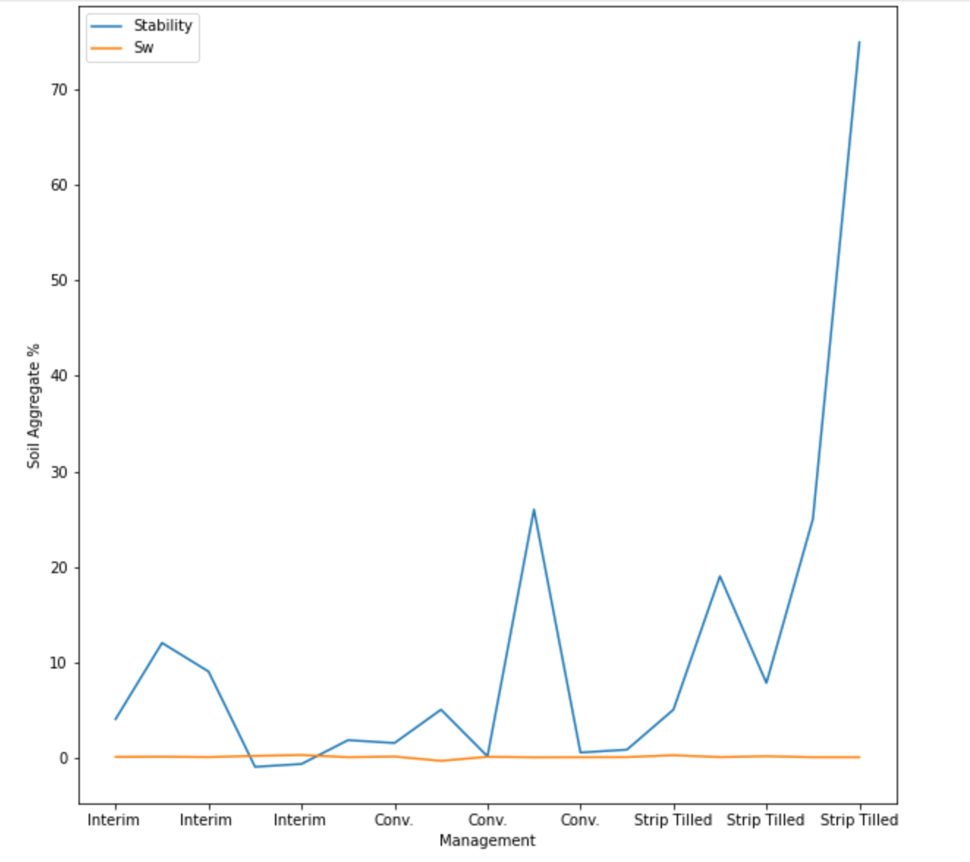
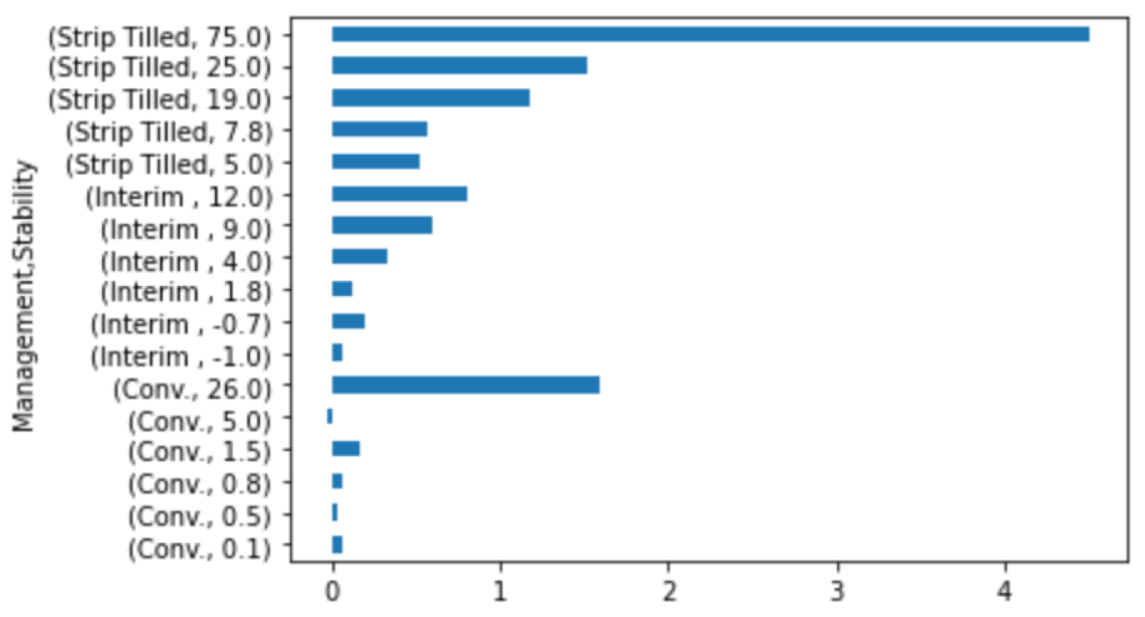
Plot Analysis
Notes:
Independent variable: tillage practices (x)
Dependent variable: soil aggregate stability
Findings:
I compared the stability of strip, interim and conventional tilled soils and plotted that on the top left corner where we see that strip tilled soils have a higher % overall.
My mean isn’t visualized here, however it was calculated and I see that both intermittent & conventional tillage have a lower percentage mean (Interim: 4.18, conven: 5.6, and strip: 26.3)
The bottom right cornered plot is me attempting to incorporate the overall sand weight of a given sample to the stability- because it is important to also attempt to correlate the aggregate sizes and quantities that also have a hand on impacting the stability of a given soil.
Clearly:

Slide 7
Results & Future Analysis
From this small sample we see that adopting strip tillage or minimizing the use of tillage on agricultural lands can have a positive impact on aggregate stability.
However:
Limitation/Challenges:
Increasing the population size is necessary to make any claims.
While also potentially comparing the macroaggregate and stability correlation further.
It may be worth it to also assess the potential negatives to reduced tillage as well.

Slide 8
Questions?

